Slide 1
Generic Wound Care - Generic Bordered Gauze package

Slide 2

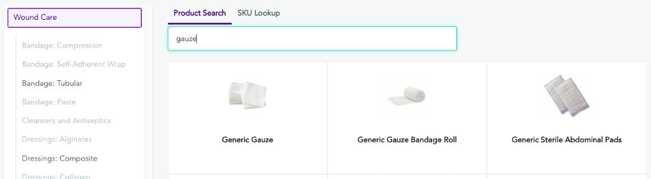
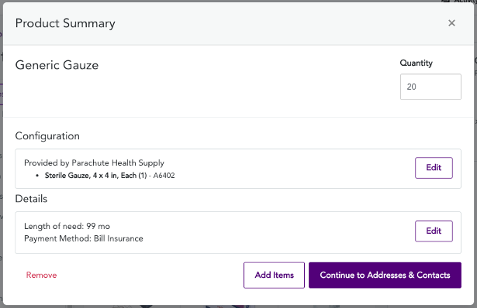

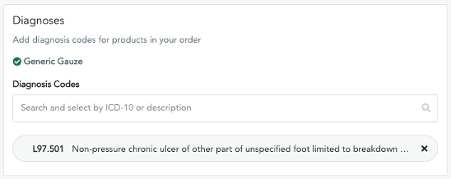


Generic Wound Care - Generic Bordered Gauze package
1
Select Your Product
1
Select Your Product
After entering the patient's name, date of birth, gender, and insurance info, you can start shopping! Either search for "Continuous Glucose Monitor Package" or select the Diabetes category.
After entering the patient's name, date of birth, gender, and insurance info - you can start shopping! Select the Wound Care category.
Up to 85% Faster
Time from Order to Delivery by ePrescribing on the Parachute Platform
2
Review Product Summary
After entering the patient's name, date of birth, gender, and insurance info, you can start shopping! Either search for "Continuous Glucose Monitor Package" or select the Diabetes category.
3
Enter Diagnosis Code(s)
After entering the patient's addresses and contacts, go to the Clinical Info Page to select the patient's diagnosis and we will tell you if it qualifies.
‹#›

Slide 3
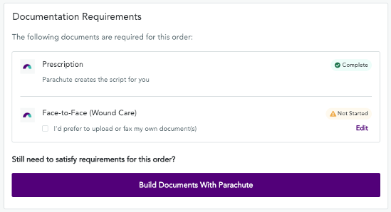
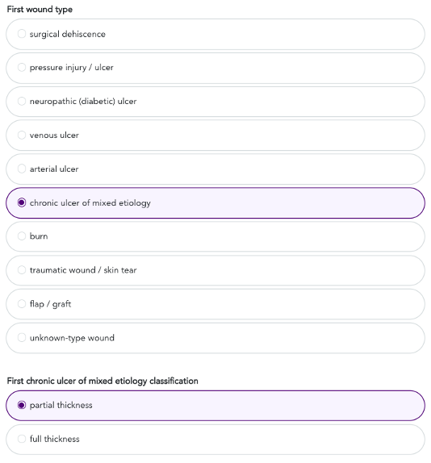
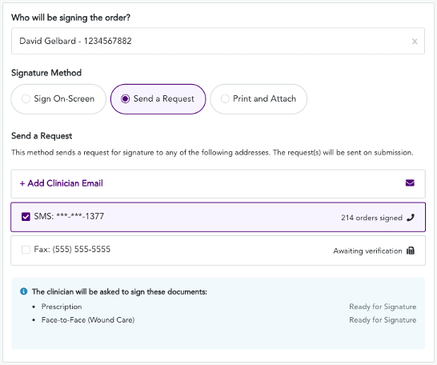

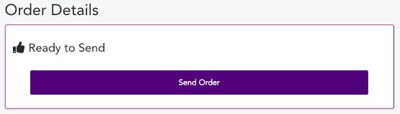
Generic Wound Care - Generic Bordered Gauze package
4
Review Document Requirements
From the Clinical Info page, you can also check which documents are required to fulfill the order, if they can be generated in Parachute or if they'll need to be attached.
5
Complete Documentation
Answer each question and add any notes at the end, if desired, then
press Continue.
6
Select the Signature Method
Sign On-Screen: If the clinician is there to press the 'Sign' button.
Send a Request via SMS: Allows the clinician to sign on their phone (most effective). You can add a clinician's cell phone number or email if it is not already entered.
7
Send Order
Review the order and press Send Order and you're done!
‹#›

